Slide 1
Module 5
XML

Slide 2
XML was designed to be that simplified version of SGML.
allow users to define their own markup languages.
HTML
markup language that is meant to describe the layout of general information
provide some guidance as to how it should be displayed
XML
Metamarkup language that provides a framework for defining specialized markup languages
XHTML is an XML-based version of HTML.

Slide 3
It provides a simple and universal way of storing any textual data.
XML is a universal data interchange language.
XML is not a markup language; it is a meta-markup language.
specifies rules for creating markup languages
XML includes no tags
the designer must define a collection of tags that are useful in the intended area.
an XML tag and its content, together with the closing tag, are called an element.

Slide 4
XML-based markup language known as a tag set
documents that use an XML-based markup language XML documents.
the data in an XML document can be displayed by browsers only if the presentation styles are provided by style sheets of some kind
XML documents are analysed by XML processor
XML processor isolates the constituent parts (such as tags, attributes, and data strings) and provides them to an application

Slide 5
The Syntax of XML
The syntax of XML has two distinct levels.
general low-level syntax of XML
- imposes its rules on all XML documents
syntactic level
- specified by either document type definitions (DTDs) or XML schemas.
- specify the set of tags and attributes that can appear in a particular document also the orders and arrangements in which they can appear.
DTD or an XML schema can be used to define an XML-based markup language.

Slide 6
An XML document includes
data elements of the document
markup declarations- instructions to the XML parser
processing instructions- instructions for an application program that will process the data described in the document
XML documents begin with an XML declaration
identifies the document as XML, provides the version number and specify an encoding standard
XML prolog:
<?xml version="1.0" encoding="UTF-8"?>

Slide 7
Comments in XML are the same as in HTML.
<!-- This is a comment -->
XML names are used to name elements and attributes.
XML name must begin with a letter or an underscore and can include digits, hyphens, and periods.
XML names are case sensitive
no length limitation for XML names

Slide 8
XML document defines a single root element
opening tag must appear on the first line of XML code
All other elements of an XML document must be nested inside the root element.
XML tags are surrounded by angle brackets.
Every XML element that have content must have a closing tag.
Elements that do not include content must use a tag of the form
<element_name />
XML tags can have attributes- specified with name–value assignments

Slide 9
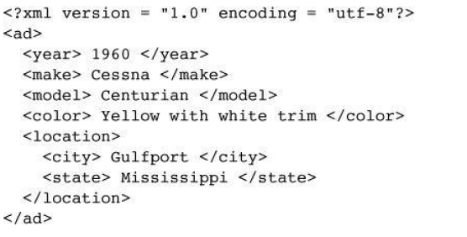
An XML document example:

Slide 10
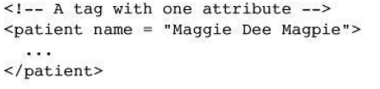
A nested element should be used if the data is subdata of the parent element’s content
Attributes are used to specify the information about the element.
three possible choices between tags and attributes:

Slide 11
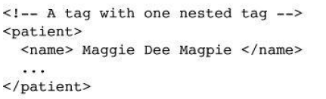
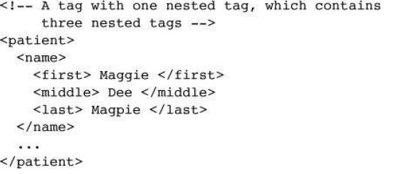

Slide 12
XML Document Structure
An XML document often uses two auxiliary files:
one that defines its tag set and structural syntactic rules
one that contains a style sheet to describe how the content of the document is to be printed or displayed.
The structural syntactic rules are given as either a DTD or an XML schema.
Two approaches to style specification are using CSS and eXtensible Stylesheet Language (XSL)

Slide 13
Document is breakdown into multiple logically related collections of information- entities.
Document entity- it includes references to the names of entities that are stored elsewhere
Every entity except the document entity must have a name.
XML processor encounters the name of a nonbinary entity in a document, it replaces the name with the value it references.

Slide 14
Entity names can be any length.
must begin with a letter, a dash, or a colon
After the first character, a name can have letters, digits, periods, dashes,underscores, or colons.
A reference to an entity is its name together with a prepended ampersand and an appended semicolon.
&apple_image;

Slide 15
Character data section
The content of a character data section is not parsed by the XML parser- any tags it may include are not recognized as tags.
The form of a character data section is:
<![CDATA[ content ]]>
For example, instead of
The last word of the line is &gt;&gt;&gt; here &lt;&lt;&lt;
the following could be used:
<![CDATA[The last word of the line is >>> here <<<]]>

Slide 16
4. Document Type Definitions(DTD)
DTD is a set of structural rules called declarations
specify a set of elements and attributes that can appear in a document, as well as how and where these elements and attributes may appear.
DTDs also provide entity definitions.
DTDs are used when the same tag set definition is used by a collection of documents

Slide 17
Internal DTD
A DTD is embedded in the XML document whose syntax rules it describes.
External DTD
DTD stored in a separate file

Slide 18
DTD is a sequence of declarations, each of which has the form of a markup declaration:
<!keyword ... >
Four possible keywords
ELEMENT, used to define tags
ATTLIST, used to define tag attributes
ENTITY, used to define entities
NOTATION, used to define data type notations.

Slide 19
4.1 Declaring Elements
element declaration in a DTD specifies the structure of one category of elements.
declaration provides the name of the element along with the specification of the structure of that element.
The form of an element declaration:
<!ELEMENT element_name (list of names of child elements)>

Slide 20
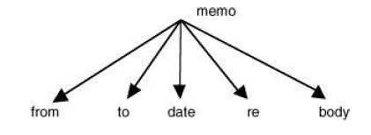
For example, consider the following declaration:
<!ELEMENT memo (from, to, date, re, body)>
Document tree structure will be

Slide 21
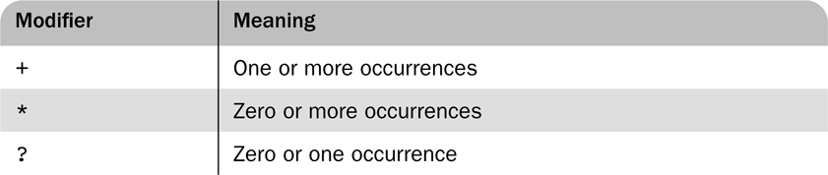
it is necessary to specify the number of times that a child element may appear.
can be done in a DTD declaration by adding a modifier to the child element specification.
Child element specification modifiers
<!ELEMENT person (parent+, age, spouse?, sibling*)>
One or more parent, one age, possibly a spouse element, and zero or more sibling elements

Slide 22
The leaf nodes of a DTD specify the data types of the content of their parent nodes
the content of an element is type PCDATA, for parsable character data
Parsable character data is a string of any printable characters except “less than” (<), “greater than” (>), and the ampersand (&).
Two other content types can be specified: EMPTY and ANY.
The EMPTY type specifies that the element has no content
The ANY type is used when the element may contain literally any content
<!ELEMENT element_name (#PCDATA)>

Slide 23
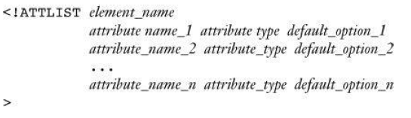
4.2 Declaring Attributes
An attribute declaration must include the name of the element to which the attribute belongs, the attribute’s name, its type, and a default option.
general form of an attribute declaration:
<!ATTLIST element_name attribute_name attribute type default_option>
If more than one attribute is declared for a given element

Slide 24
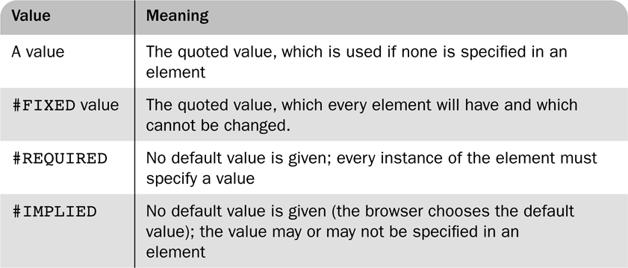
There are 10 different attribute types.
CDATA is commonly used
default option in an attribute declaration can specify either an actual value or a requirement for the value of the attribute
Possible default options for attributes

Slide 25
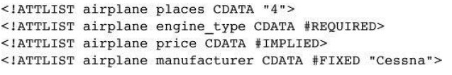
For example, suppose the DTD included the following attribute specifications:
Then the following XML element would be valid for this DTD:
<airplane places = “10” engine_type = “jet”> </airplane>

Slide 26
4.3 Declaring Entities
Entities defined so that they can be referenced anywhere in the content of an XML document- general entities.
Predefined entities are all general entities.
Entities defined so that they can be referenced only in DTDs- parameter entities
The form of an entity declaration is
<!ENTITY [%] entity_name “entity_value”>
the optional percent sign (%) is present in an entity declaration- specifies that the entity is a parameter entity

Slide 27
example of an entity
<!ENTITY mace “Mar Athanasius College of Engineering ”>
Any XML document that uses a DTD that includes this declaration can specify the complete name with just the reference &mace;.
When an entity is longer than a few words, its text is defined outside the DTD- external text entity
The form of the declaration of an external text entity is
<!ENTITY entity_name SYSTEM “file_location”>
The keyword SYSTEM specifies that the definition of the entity is in a different file, which is specified as the string following SYSTEM.

Slide 28
XML parsers check documents that have DTDs in order to ensure that the documents conform to the structure specified in the DTDs
These parsers are called validating parsers.
Validating XML parsers detect and report all inconsistencies in documents relative to their DTDs.

Slide 29
4.5 Internal and External DTDs
Internal DTD
the DTD is included in the XML code, it must be introduced with
<!DOCTYPE root_name [ and terminated with ]>
Eg:
<? xml version=“1.0” encoding=“utf-8”?>
<!DOCTYPE planes_for_sale [
<!-- DTD for Planes-- >
]>
<!-- Xml document for planes-- >

Slide 30
Extrenal DTD
the DTD is in a separate file
declaration has the following form:
<!DOCTYPE XML_document_root_name SYSTEM “DTD_file_name”>
Eg: assuming that the DTD is stored in the file named planes.dtd
<!DOCTYPE planes_for_sale SYSTEM planes.dtd”>

Slide 31
xml example.docx.

Slide 32
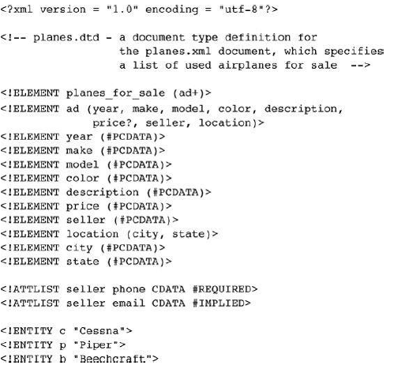

Slide 33
5 Namespaces
XML namespace is a collection of element and attribute names used in XML documents.
name of a namespace usually has the form of a uniform resource identifier (URI)
A namespace for the elements and attributes is declared as the value of the attribute xmlns.
The form of a namespace declaration for an element is
<element_name xmlns[:prefix] = URI>
Prefix- optional, the name that must be attached to the names in the declared namespace
Eg:
<birds xmlns:bd = “http://www.audubon.org/names/species”>

Slide 34
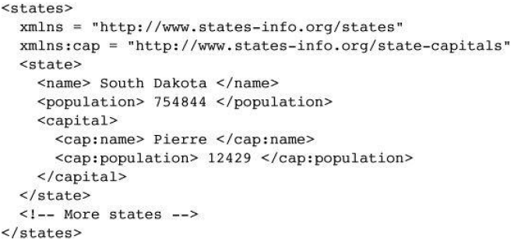

Slide 35
6 XML Schemas
DTDs have several disadvantages
DTDs are written in a syntax unrelated to XML.
DTDs do not allow restrictions on the form of data that can be the content of a particular tag.
there are only 10 data types, none of which is numeric.
the content of an element could be an integer number, a floating-point number, or a range of numbers. All of these would be specified as text

Slide 36
XML Schema standard was designed by the W3C
have been developed to attempt to overcome the weakness of DTD
An XML schema is an XML document- can be parsed with an XML parser
provides far more control over data types
There are 44 different data types
Also, the user can define new types with constraints on existing data types.
Eg: a numeric data value can be required to have exactly seven digits.
XML Schema was designed to allow any DTD to be automatically converted to an equivalent XML schema.

Slide 37
6.1 Schema Fundamentals
Schemas can be related to the idea of a class and an object.
A schema is similar to a class definition;
A schema is similar to a class definition; an XML document that conforms to the structure defined in the schema is similar to an object of the schema’s class
Schemas have two primary purposes
schema specifies the structure of its instance XML documents
a schema specifies the data type of every element and attribute in its instance XML documents.

Slide 38
XML schemas are “namespace centric.”
namespaces are represented by names that have the form of URIs.

Slide 39
6.2 Defining a Schema
Schemas themselves are written with the use of a collection of tags, or a vocabulary, from a namespace
The namespace used is http://www.w3.org/2001/XMLSchema.
the elements in the namespace are
element,
schema,
sequence, and
string.

Slide 40
Every schema has schema as its root element.
schema element specifies the namespace for the schema of schemas
also specifies a prefix that will be used for the names in the schema.
namespace specification appears as follows:
xmlns:xsd = http://www.w3.org/2001/XMLSchema

Slide 41
The name of the namespace defined by a schema must be specified with the targetNamespace attribute of the schema element.
The name of every top-level (not nested) element that appears in a schema is placed in the target namespace
targetNamespace = http://cs.uccs.edu/planeSchema
If the elements and attributes are nested inside top-level elements are to be included in the target namespace- schema’s elementFormDefault must be set to qualified
elementFormDefault = “qualified”

Slide 42
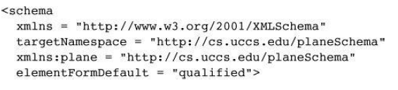
Schema definition example:

Slide 43
6.3 Defining a Schema Instance
An instance of a schema must include specifications of the namespaces it uses.
These specifications are given as attribute assignments in the tag for the root element of the schema.
First attribute specifies default namespace to be the one defined in its schema
<planes
xmlns = http://cs.uccs.edu/planeSchema
... >

Slide 44
second attribute is used to name the standard namespace for instances- includes the name XMLSchema-instance.
xmlns:xsi = http://www.w3.org/2001/XMLSchema-instance
Third, the instance document must specify the filename of the schema in which the default namespace is defined
schemaLocation attribute is used
two values: the namespace of the schema and the filename of the schema.

Slide 45
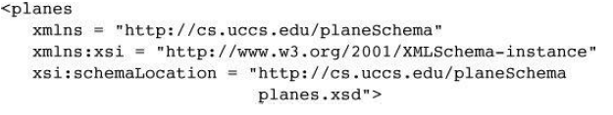
the opening root tag of an XML instance of the planes.xsd schema, where the root element name in the instance is planes

Slide 46
6.4 An Overview of Data Types
two categories of user-defined schema data types: simple and complex.
A simple data type is a data type whose content is restricted to strings
A simple type cannot have attributes or include nested elements.
a large collection of predefined data types is included in the category.
A complex type can have attributes and include other data types as child elements.

Slide 47
The XML Schema defines 44 data types, 19 of which are primitive and 25 of which are derived.
The primitive data types include
string, Boolean, float, time, and anyURI.
The predefined derived types include byte, long, decimal, unsignedInt, positiveInteger, and NMTOKEN
User-defined data types are defined by specifying restrictions on an existing type
Then existing data type are called a base type and user-defined types are derived types

Slide 48
Constraints on derived types are given in terms of the facets of the base type.
Eg:
the integer primitive data type has eight possible facets: totalDigits, maxInclusive, maxExclusive, minInclusive, minExclusive, pattern, enumeration, and whitespace
Both simple and complex types can be named or anonymous.
If anonymous, a type cannot be used outside the element in which it is declared.
context is essential to defining the meaning of a reference to an element in an XML schema.

Slide 49
Data declarations in an XML schema can be either local or global
A local declaration is a declaration that appears inside an element that is a child of the schema element (a declaration in a grandchild element of schema)
A locally declared element is visible only in that element.
A global declaration is a declaration that appears as a child of the schema element.
Global elements are visible in the whole schema in which they are declared

Slide 50
6.5 Simple Types
Elements are defined in an XML schema with the element tag, which is from the XMLSchema namespace
prefix xsd is normally used for names from this namespace
name attribute gives the name of element
Type attribute, which is used to specify the type of content allowed in the element
<xsd:element name = “engine” type = “xsd:string” />

Slide 51

An instance of the schema in which the engine element is defined could have the following element:
<engine> inline six cylinder fuel injected </engine>
An element can be given a default value with the default attribute:

Slide 52
Elements can have constant values defined using fixed attribute

Slide 53
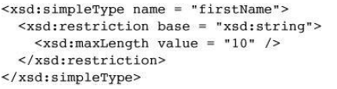
A simple user-defined data type is described in a simpleType element
Facets must be specified in the content of a restriction element, which gives the base type name.
The facets themselves are given in elements named for the facets: the value attribute specifies the value of the facet.
user-defined type, firstName, for strings of fewer than 11 characters:

Slide 54
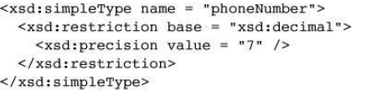
length facet is used to restrict the string to an exact number of characters
minLength facet is used to specify a minimum length
The number of digits of a decimal number can be restricted with the precision facet

Slide 55
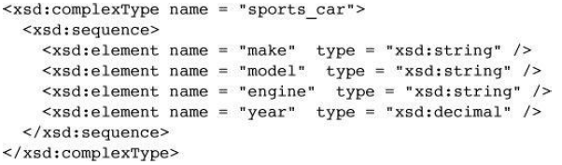
6.6 Complex Types
defined with the complexType tag
The elements that are the content of an element-only element must be contained in an ordered group, an unordered group, a choice, or a named group.
The sequence element is used to contain an ordered group of elements

Slide 56
A complex type whose elements are an unordered group is defined in an all element.

Slide 57
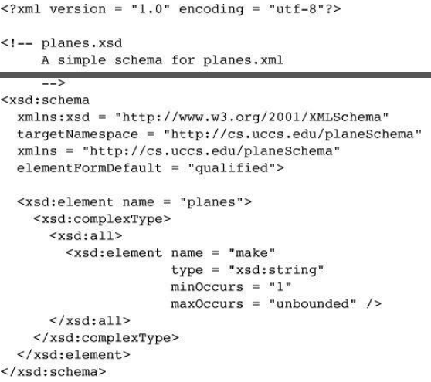
Example -xml schema

Slide 58
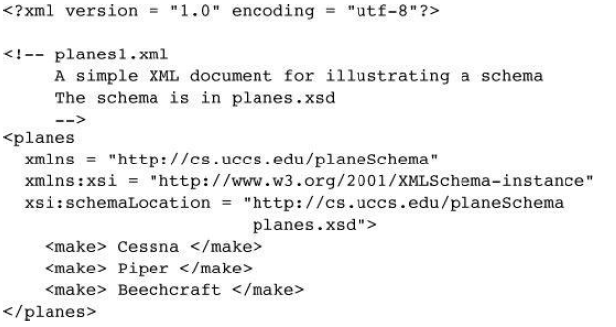
Xml document:

Slide 59
6.7 Validating Instances of Schemas
several XML schema validation tools are available.
One of them is named xsv( XML Schema Validator).
The output of xsv is an XML document.

Slide 60
7. Displaying Raw XML Documents
style sheet defines presentation styles for the document’s tags
if an XML document is displayed without a style sheet, document will not have formatted content.
Contemporary browsers include default style sheets- used when no style sheet is specified in the XML document.
The display of such an XML document is only a document tree( somewhat stylized listing of the XML markup).

Slide 61
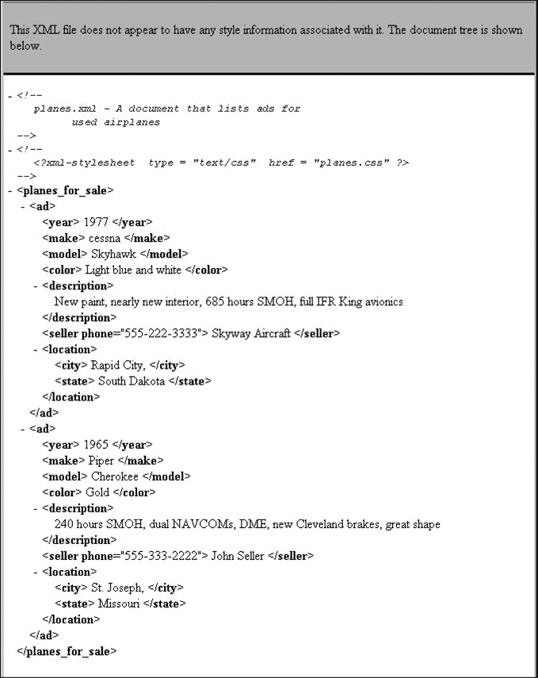
A display of an XML document with the FX3 default style sheet

Slide 62
8. Displaying XML Documents with CSS
Style-sheet information can be provided to the browser for an XML document in two ways
Cascading Style Sheet (CSS)
XSLT style-sheet
using CSS is effective,
XSLT provides far more power over the appearance of the document’s display.

Slide 63
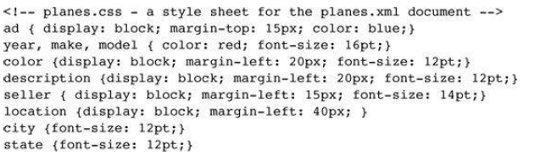
CSS style sheet for an XML document is simple.
It is a list of element names, each followed by a brace-delimited set of attributes.
Example:

Slide 64
Display property- used to specify whether an element is to be displayed inline or in a separate block.
two options are specified with the values inline and block.
The inline value is the default
When display is set to block, the content of the element is usually separated from its sibling elements by line breaks.

Slide 65
The connection of an XML document to a CSS style sheet is established with the processing instruction xml-stylesheet
Two attributes
type: specifies the particular type of the style sheet
href: name of the file that stores the style sheet
<?xml-stylesheet type = “text/css” href = “planes.css” ?>

Slide 66
9. XSLT Style Sheets
eXtensible Stylesheet Language (XSL) is a family of recommendations for defining the presentation and transformations of XML documents
consists of three related standards:
XSL Transformations (XSLT),
XML Path Language (XPath),
XSL Formatting Objects (XSL-FO)

Slide 67
XSLT style sheets are used to transform XML documents into different forms or formats
XSLT transforms XML documents into XHTML documents, primarily for display
XPath is a language for expressions
used to identify parts of XML documents

Slide 68
9.1 Overview of XSLT
XSLT : simple functional-style programming language
XSLT includes functions, parameters, names to which values can be bound, selection constructs, and conditional expressions for multiple selection.
The syntactic structure of XSLT is XML

Slide 69
The transformation process used by an XSLT processor
XSLT processors take both an XML document and an XSLT document as input.
XSLT document is the program to be executed
XML document is the input data to the program.
Parts of the XML document are selected, possibly modified, and merged with parts of the XSLT document to form a new document, ie, XSL document

Slide 70
XSL document is also an XML document
XSL document could be again the input to an XSLT processor
The output document can be stored for future use by applications, or it may be immediately displayed by an application
Neither the XSLT document nor the input XML document is changed by the XSLT processor.

Slide 71
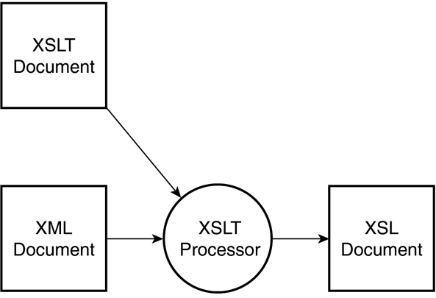
XSLT processing

Slide 72
XSLT document consists primarily of one or more templates
It uses XPath to describe element–attribute patterns in the input XML document
each template describes a function that is executed whenever the XSLT processor finds a match to the template’s pattern.
XSLT processor sequentially examines the input XML document
searching for parts that match one of the templates in the XSLT document.

Slide 73
XSLT model of processing XML data
template-driven model: highly regular data collections, files containing records.
data-driven model: irregular and recursive data, using template fragments

Slide 74
9.2 XSL Transformations for Presentation
XSLT style-sheet document is included into an xml document using the following processing instruction

